Slide 1
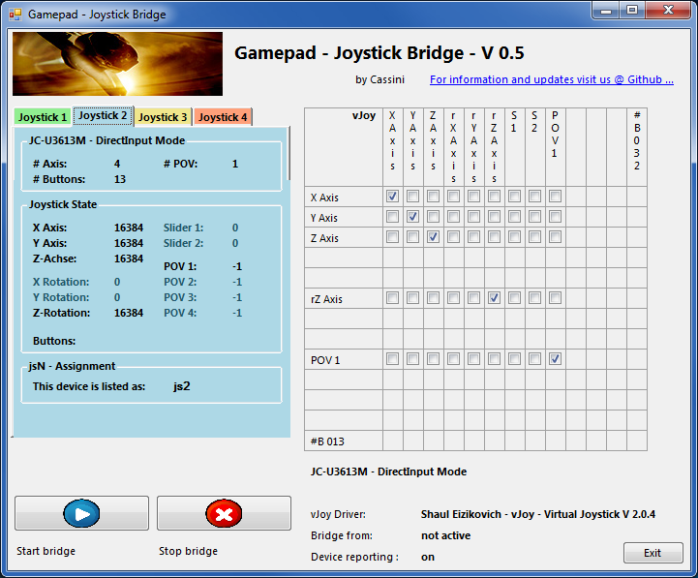
DirectInput Gamepad Joystick Bridge Quick Reference Guide V 0.50 BETA
20141223 – Cassini
ChangeLog: see ReadMe.txt
Disclaimer:
Usual stuff – no warranty whatsoever..
Freeware – made for the SC community
Hope it helps and does not suck.
Have fun in the verse …

Slide 2
Updating from V 0.x to V 0.50:
Install the vJoy driver from http://vjoystick.sourceforge.net/
Configure according to the guide following
If you encounter an error or crash then read on…
You will find ‘log4net.config.OFF’ in the distribution zip. Rename it to ‘log4net.config’ and run the program. Then look for a file named ‘trace.log’ in the program folder and send this to cassini@burri-web.org along with a description of the problem and your system i.e. OS, CPU, Graphics card, Joystick(s) we may then finally solve the issue …

Slide 3
Contents
Page 2 Version Upgrade and Issue Handling
Page 3 Contents (this one…)
Page 4.. Workflow - General GUI and how to’s

Slide 4
Workflow
Rationale: There are some USB adapters that will map game control devices as DirectInput Gamepads – however some programs do not recognize those as valid game controllers…
This program is intended to bridge DirectInput Gamepad devices to Joystick devices using a virtual Joystick driver.
NOTE: Xpad compliant Gamepads don’t need this program.
Install the vJoy driver from http://vjoystick.sourceforge.net/ *)
Go for the vJoy installation folder (C:\Program Files\v Joy) and run ‘JoyMonitor.exe’ and ‘vJoyFeeder.exe’ There you should be able to see device #3 and play with the Feeder and see the actions in the Monitor. If this works you may continue.
Connect the game control devices to the PC
See next pages for the following procedure:
Start this program and note the needed capabilities of the device to bridge
Start the vJoy Configuration program an setup the driver accordingly
Exit and re-start this program (do get the changes inherited)
Choose the tab with the controller to bridge
Click Start Bridge
Go for the vJoy tab and see if the controls are reported
Run your favorite game and use the vJoy device as Joystick… - have fun
*) NOTE: It may happen that while you install the driver the GUI will just not disappear (wait ~10Minutes).
Open the Win Task Manager and look for ‘vJoyInstall.exe’ and just kill it.
You should then be able to continue and everything is installed

Slide 5
The GUI …
Detected Game devices
(up to 8 are shown)
vJoy properties available
Device properties available
Bridge mapping
Row=IN, Col=OUT (to vJoy)
Start Bridge with the active device (here the JC-U3612M)
Device map shown
Status Information
Stop Bridge

Slide 6
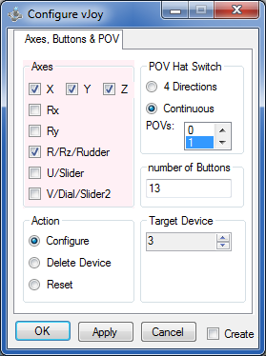
First Run - Setup
First check the needed vJoy device properties:
The device we want to bridge is a gamepad with 4 axes, a POV and 13 buttons.
Go to the installation folder of the vJoy driver (mostly C:\Program Files\v Joy) and run vJoyConf.exe.
There you have to setup for at least the items that your device will need.
As shown right I set up the vJoy device having those items.
Close the Bridge program and then click OK on the Configurator (the driver is then reconfigured)
NOTE: Use Target Device 3 (that is the default one which comes pre-installed)
Also the Config tool does not read the current setting – it starts always with the same defaults.
Use “Continuous” POV – here I have chosen to have ONE only

Slide 7
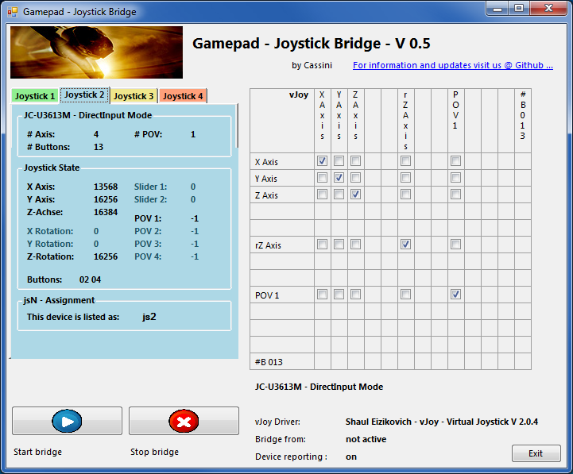

Second Run – Test …
Restarting the Bridge Program …
You can see that the vJoy device just maps to your device.
Now you can play with the controls and see if those are working on the original device tab (here the blue one)
Note: if the program does not have the focus it will not report device movements
Also the Bridge is not yet active.

Slide 8
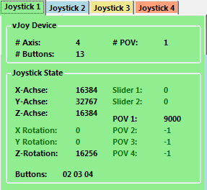


Second Run – Run
Ready to Bridge …
Click the Start Button
Hopefully the program is now bridging the Blue device to the green vJoy device.
Now any handling with the blue device is forwarded to the vJoy device and should be visible there.
Click the vJoy Tab and see if it works.
Use e.g. SCJMapper in parallel and see if things are working. Then start your favorite game (AC…) and enjoy…
Most likely you have to setup your game control maps to fit your needs.
Stop when you’re done – the bridging stops.

